Slide 1
Threading and Parallel Processing
INFO 1182 / CS 1182
Using C#

Slide 2
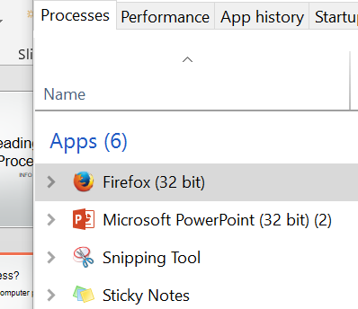
What is a process?
Process – Instance of a running computer program.
32 bit Version of Firefox is running
Ctrl+Space+Esc

Slide 3
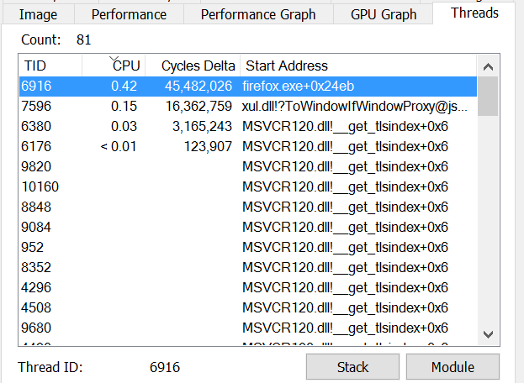
What is a Thread?
Threads are the smallest running parts of a process.

Slide 4
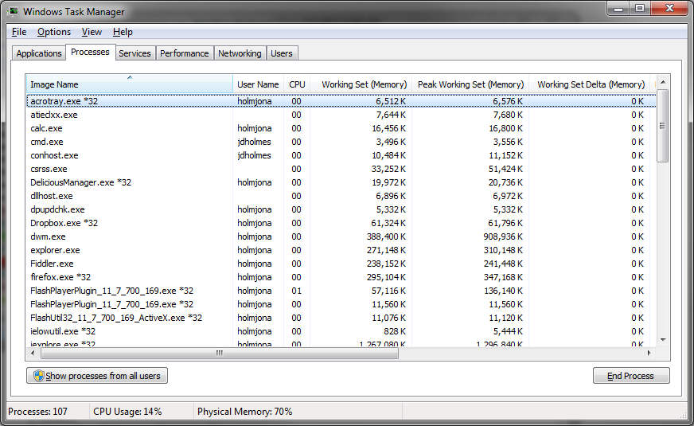
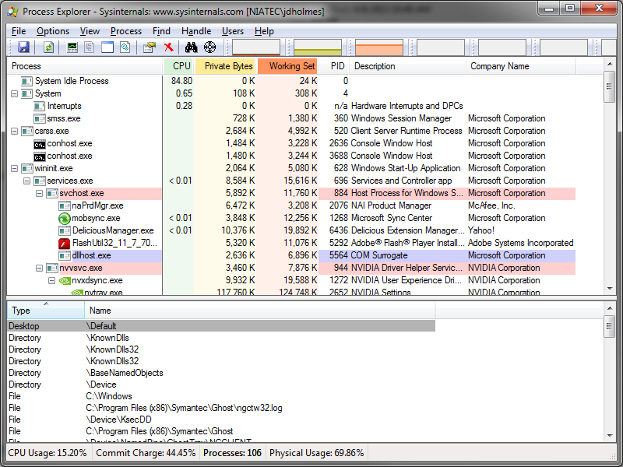
Viewing Running Processes
Windows Task Manager
Ctrl+Shift+Esc
Process Explorer
Task Manager on Steroids
http://technet.microsoft.com/en-us/sysinternals/bb896653

Slide 5
Multi-threading
Multi-threaded Application
A program written to create many threads.
PCB
PCB
Code
Data
Files
Code
Data
Files
Registers
Stack
Registers
Registers
Registers
TCB
Stack
Stack
Stack
TCB
TCB
TCB
Thread

Slide 6
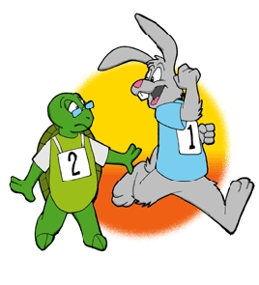
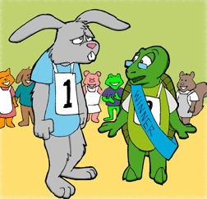

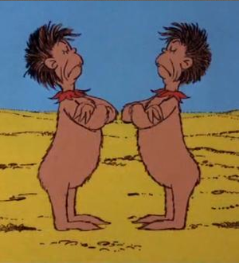
Concerns
Race Conditions
Threads finish in unexpected order.
Deadlock
Threads lock resources they need to complete.

Slide 7




Mutex
One resource.
Wanted by many users.

Slide 8
Semaphore (Simplified)
One resource – several seats.
Wanted by many users.

